Slide 1

Design & Building Smart Energy Meter
Submitted to : HJD Institute of Technical Education & Research
Project Guide : Prof. Mayur Thacker
Developed By:
1. KHATRI MAYUR J [130853109015]
2. CHAVDA SAURABH D [130853109008]
3. JOGI SANJAY D [120850109045]
4. ZALA SHIVRAJSINH K [110850109028]

Slide 2
Outline
Abstract
Team Structure
Problem Statement
1
2
3
Problem Solution
Technical Architecture
Use Case Diagrams / Block Diagrams
4
5
6
Product Features
Algorithms
Bibliography
7
8
9

Slide 3
1. Abstract
The demand for power has increased exponentially over the last century. one avenue through which today’s energy problems can be addressed is through the reduction of energy usage in households. This has increased the emphasis on the need for accurate and economic methods of power measurement.
The main object of the project is to develop smart energy meter is not only measure the consumer’s power consumption in KWH but also to enable and support real consumption in rupees according to consumer tariff, so meter reader don’t need to visit each customer for the consumed data collection and to distributed the bill slips. In our invented meter we do not have any rotating parts .The energy consumption is calculated using measurement voltage and current with help of potential divider and ACS712 ,measure voltage and current respectively. Power product of voltage and current, its unit watt or KW and energy is product of power (watt) and time (Hour).

Slide 4
1. Abstract (Conti…)
so we use mentioned standard formula and using Arduino Microcontroller Programming , we are calculating total energy consumption of consumer load.
Microcontroller has an interface in size of 16*2 LCD, it shows important data dimensions such as voltage, current,, active and power and energy consumption it also shows power qualities.

Slide 5
2. Team Structure
Team Lead & Lead Architect
Khatri Mayur
Team Member
Chavda Saurabh
1
2
Team Member
Jogi Sanjay
Team Member
Zala Shivrajsinh
3
4

Slide 6
3. Problem Statement
Traditional energy meter have following disadvantages:
The basic working of Single phase induction type Energy Meter is on two mechanisms:
Mechanism of rotation of an aluminum disc which is made to rotate at a speed proportional to the power.
Mechanism of counting and displaying the amount of energy has been transferred.
Hence, this system has moving characteristics , accuracy would be less.

Slide 7
3. Problem Statement (Conti…)
This system has following errors are being observed:
Friction
Phase
Speed
Temperature
Frequency
Overload

Slide 8
3. Problem Statement (Conti…)
Consumer of this system would not be able to get real value of their consumption usage.
Biggest disadvantage of this system is Security and Privacy, this system can be easily theft by consumer, such as by doing unethical tricks such as by using magnet and other connection changes user can stop the meter while also getting energy, user will not be billed for this energy consumption.

Slide 9
4. Provided Solution
Kick Off | Design | Development | Testing | GoLive
20/07/2015
15/09/2015
25/01/2016
01/04/2015
31/04/2015

Slide 10
5. Features
This system doesn't have any moving mechanism, so it would give accurate reading of energy consumption.
This is Micro-controller based meter so there would be no issue of power thief.
Consumer can easily get awareness about their energy consumption in real value so they can control their energy consumption.
Smart Energy meter has User Interface when consumer can easily check their energy consumption by Mobile / Computer.

Slide 11
5. Features (Conti…)
This system is secure, not easily vulnerable.
Has Advanced metering technology.
Has Remote control
Having Better performance.
Has Power monitoring.

Slide 12
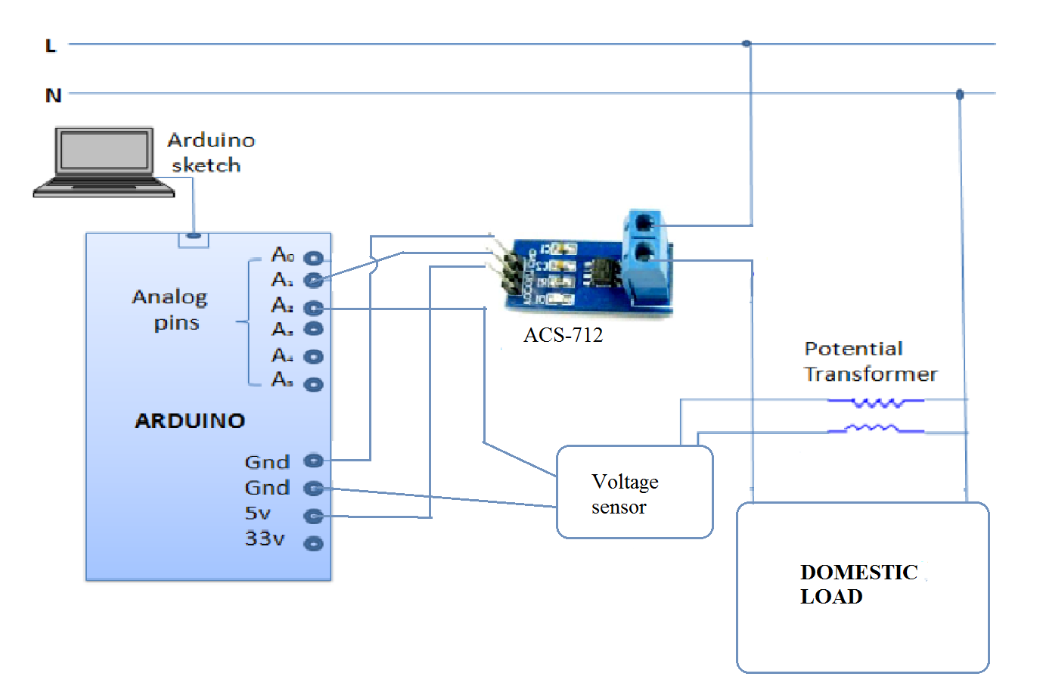
6. Diagram’s
6.1 Component Diagram

Slide 13
6. Diagram’s (Conti…)
6.2 Block Diagram
LCD Display
GSM Shield
Arduino Uno microcontroller
Current sensor module ACS 712(Hall effect sensor)
Voltage sensor
LCD display 16*2 character
GSM shield
Microcontroller (Arduino)
PT
Load
Neutral
Phase
CT

Slide 14
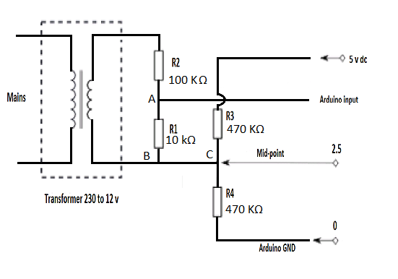
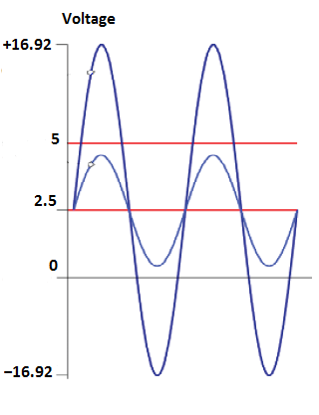
6. Diagram’s (Conti…)
6.3 Voltage Sensor Circuit Diagram
230v to 12v
1.54
230v to 12v
10/ 10 +100 * 12 * √2
1.54 + 2.5
(-1.54 + 2.5)

Slide 15
7. Detailed Technical Architecture
7.1 Architecture
7.2 Used Tools & Technologies
7.2.1 Softwares
7.2.2 Hardwares
7.2.3 Datasheet Diagrams of Hardwares

Slide 16
7. Detailed Technical Architecture (Conti…)
7.1 Architecture
The meter consists of a microcontroller, a current sense by ACS - 712 current sensor module, a voltage feedback section consisting of a voltage transformer, a signal conditioning circuit and 16*2 LCD display.
The GSM 900A module is used for communication between energy meter to the consumer or energy suppler.

Slide 17
7. Detailed Technical Architecture (Conti…)
7.1 Architecture (Conti…)
Main Supply(230v ac)
Arduino Microcontroller
LCD Display
Voltage & Current Sensor
Mobile
Device
Load
GSM

Slide 18
7. Detailed Technical Architecture (Conti…)
7.1 Architecture (Conti…)
In voltage measurement circuit AC voltage is step down with help of voltage transformer, its primary winding is connected across the supply and its secondary winding is connected to voltage divider circuit for reduced further voltage level and add dc voltage offset for negetive portion of signal.
voltage and current are measure with help of sensor and its interfaced to Arduino microcontroller it measure the energy consumption .
16*2 lcd display use to display all energy measurement parameter.
The gsm module use communication in both direction.

Slide 19
7. Detailed Technical Architecture (Conti…)
7.2 Used Tools & Technologies
Hardwares | Softwares & Libraries
1. Arduino Uno MicroController | 1. Arduino IDE
2. Breadboard | 2. C Programming Lang.
3. LCD | 3. SoftwareSerial Library
4. GSM Module | 4. LiquidCrystal Library
5. USB Cables
6. Other Cables
7. Mobile Device

Slide 20

Smart Energy Meter

Slide 21
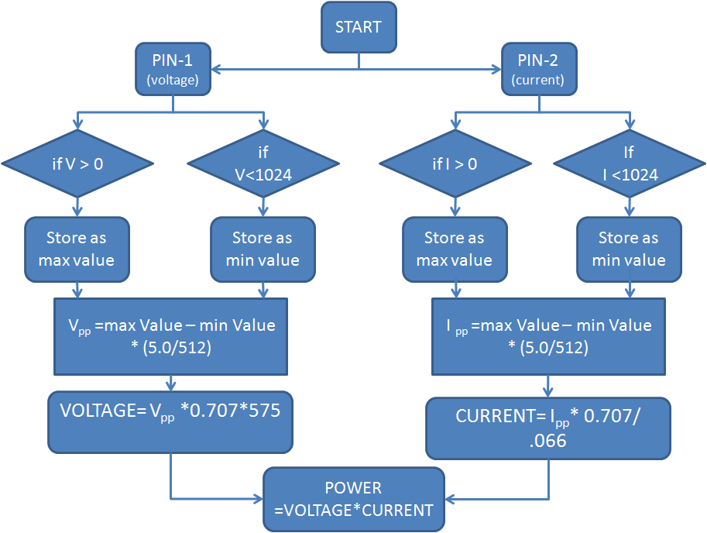
8. Algorithms
8.1 Flow Chart Diagram

Slide 22
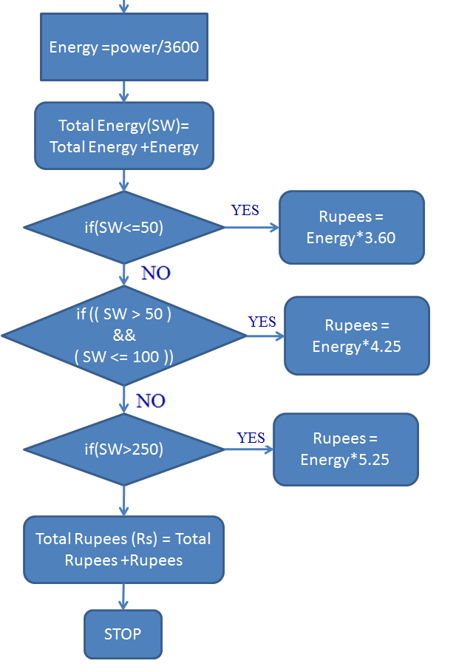
8. Algorithms
8.2 Consumption and Tariff Calculation Algorithm

Slide 23

Screenshots

Slide 24
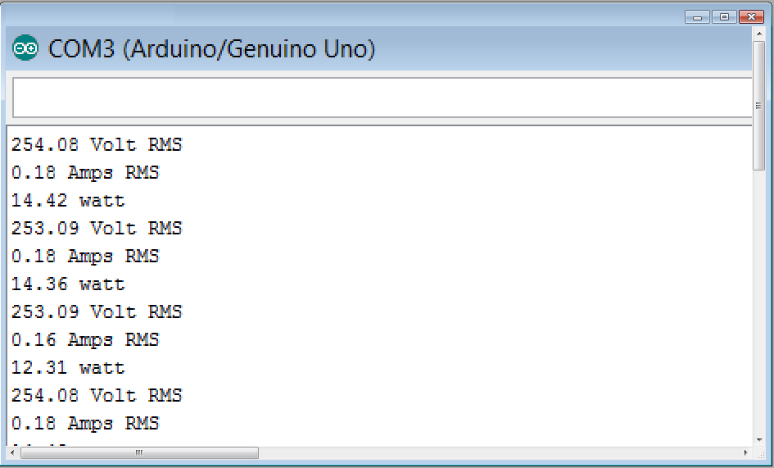
Screenshots
1) 15 watt lamp load

Slide 25
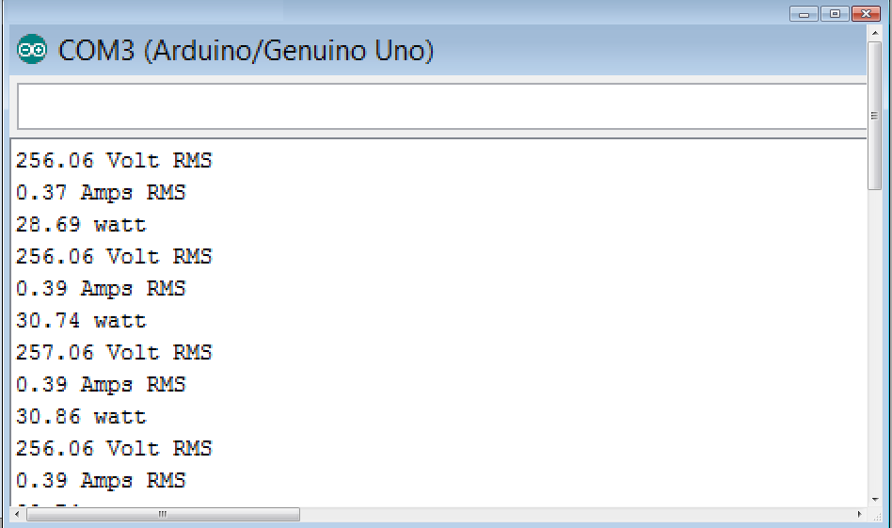
Screenshots
2) 30 watt CFL lamp load

Slide 26
9. Bibliography
[1] | An Automated Energy Metering System - Home Based Approach Aswathy P.R1, C.Shanthi2
[2] | A COGNITIVE ENERGY DISTRIBUTION SYSTEM SANUKRISHNAN S.B.
[3] | A Novel Approach for Automatic Monitoring of Power Consumption using Smart Meter P. Saraswathi1, M. Prabha2
[4] | YoMo - The Arduino-based Smart Metering Board Christoph Klemenjak, Dominik Egarter, and Wilfried Elmenreich Institute of Networked and Embedded SystemsAlpen-Adria-Universit¨atKlagenfurt,Austria {name.surname}@aau.at
[

Slide 27
9. Bibliography (Conti…)
[5] | Development of a prototype for remote current measurements of PV panel using WSN S. Zahurula*, N. Mariuna , V. Grozescub , M. Lutfia , H. Hashima, M. Amrana, Izhamc
[6] | Design and Building of a Cheap Smart Meter Arne Ellerbrock, Student Member, IEEE, Ahmad Abdel-Majeed
[7] | Energy and Water Monitoring System for Smart Metering and Consumer Awareness Shiu Kumar
[8] | Programming in ANSI C Balagurusamy Tata McGraw-Hill Education, 2008
[9] | MOOC - Coursera - The Arduino Platform and C Programming by Prof. Ian Harris Associate Professor, The University of California, Irvine

Slide 28
9. Bibliography (Conti…)
[10] | MOOC - Coursera - Interfacing with the Arduino by by Prof. Ian Harris Associate Professor, The University of California, Irvine
[11] | Getting Started with Arduino, 2nd Edition By Massimo Banzi
[12] | Arduino Cookbook 2nd Edition by Michael Margolis
[13] | ARDUINO WITH GSM - Making a Call & Sending SMS Ref. https://youtu.be/WAvZ3SSQR74
[14] | Arduino connected to an Android phone via Bluetooth (JY-MCU module) Ref. https://youtu.be/K1S6G4_eCZM
[15] | Arduino Tutorial Series by Jeremy Blum Ref. https://youtu.be/fCxzA9_kg6s?list=PLA567CE235D39FA84

Slide 29
Smart Energy Meter
Thank you !
Presented By:
1. KHATRI MAYUR J [130853109015]
2. CHAVDA SAURABH D [130853109008]
3. JOGI SANJAY D [120850109045]
4. ZALA SHIVRAJSINH K [110850109028]

